Slide 1
String
java.lang Package

Slide 2
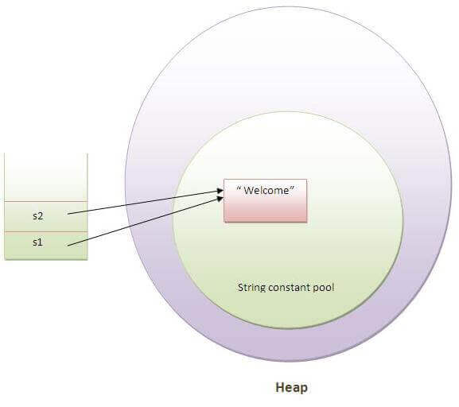

Slide 3
Strings, which are widely used in Java programming, are a sequence of characters. In Java programming language, strings are treated as objects.
The Java platform provides the String class to create and manipulate strings.
Creating Strings
The most direct way to create a string is to write −
String greeting = "Hello world!";
Whenever it encounters a string literal in your code, the compiler creates a String object with its value in this case, "Hello world!'.
As with any other object, you can create String objects by using the new keyword and a constructor. The String class has 11 constructors that allow you to provide the initial value of the string using different sources, such as an array of characters.

Slide 4
Note − The String class is immutable, so that once it is created a String object cannot be changed. If there is a necessity to make a lot of modifications to Strings of characters, then you should use String Buffer & String Builder Classes.
String Length
Methods used to obtain information about an object are known as accessor methods. One accessor method that you can use with strings is the length() method, which returns the number of characters contained in the string object.
The following program is an example of length(), method String class

Slide 5
public class StringDemo {
public static void main(String args[]) {
String palindrome = "Dot saw I was Tod";
int len = palindrome.length();
System.out.println( "String Length is : " + len );
}
}

Slide 6
Concatenating Strings
The String class includes a method for concatenating two strings −
string1.concat(string2);
This returns a new string that is string1 with string2 added to it at the end. You can also use the concat() method with string literals, as in −
"My name is ".concat("Zara");
Strings are more commonly concatenated with the + operator, as in −
"Hello," + " world" + "!"
which results in −
"Hello, world!"

Slide 7
public class StringDemo {
public static void main(String args[]) {
String string1 = "saw I was ";
System.out.println("Dot " + string1 + "Tod");
}
}

Slide 8
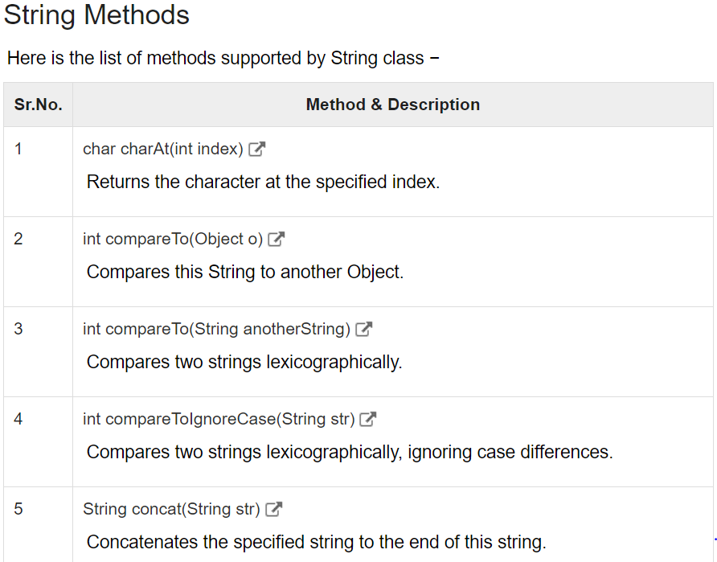
String Methods
Here is the list of methods supported by String class −

Slide 9
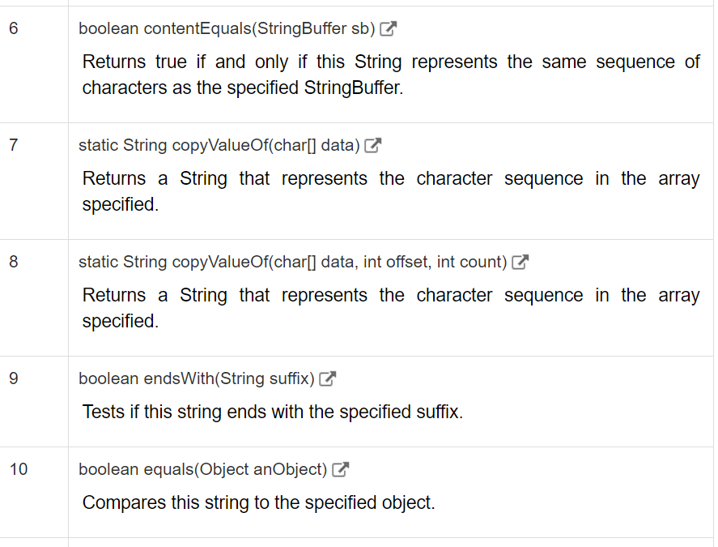

Slide 10
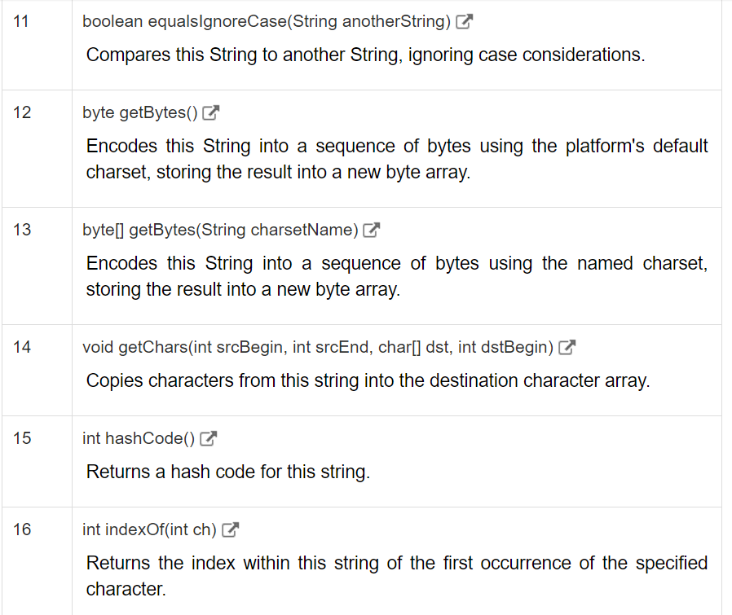

Slide 11
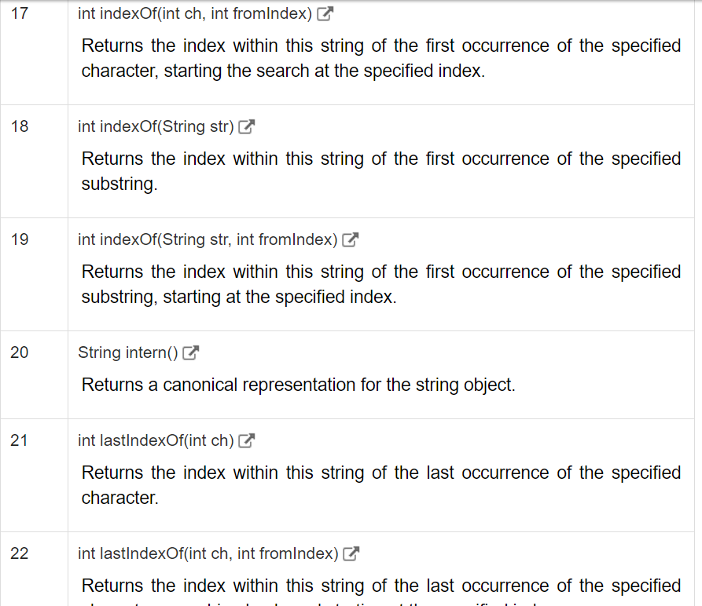

Slide 12
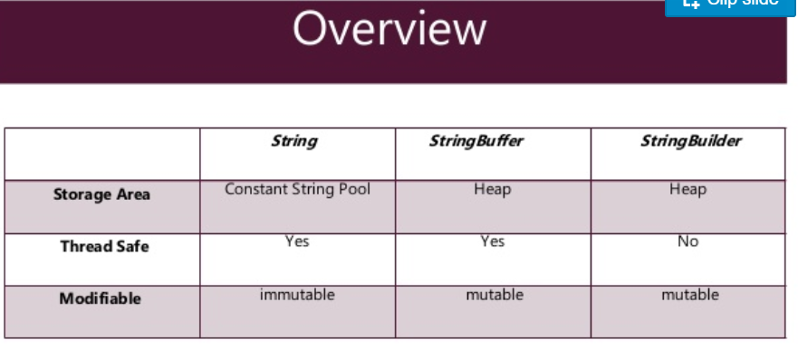

Slide 13
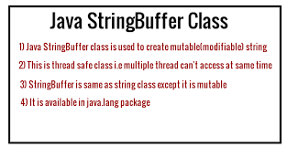

Slide 14
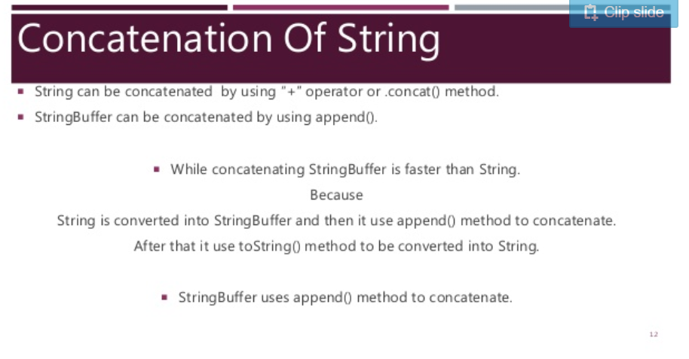

Slide 15
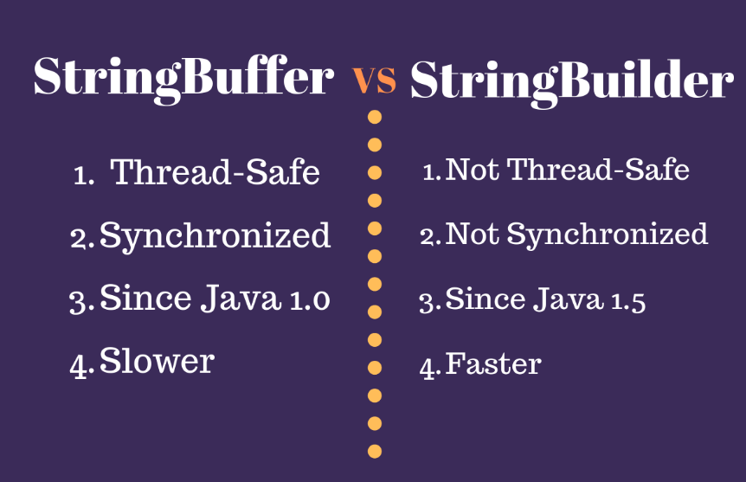

Slide 16
String vs StringBuffer
Since String is immutable in Java, whenever we do String manipulation like concatenation, substring etc, it generates a new String and discards the older String for garbage collection.
These are heavy operations and generate a lot of garbage in heap. So Java has provided StringBuffer and StringBuilder class that should be used for String manipulation.
StringBuffer vs StringBuilder
StringBuffer was the only choice for String manipulation till Java 1.4 but it has one disadvantage that all of its public methods are synchronized. StringBuffer provides Thread safety but on a performance cost.

Slide 17
In most of the scenarios, we don’t use String in a multithreaded environment, so Java 1.5 introduced a new class StringBuilder that is similar to StringBuffer except thread safety and synchronization.
So if you are in a single threaded environment or don’t care about thread safety, you should use StringBuilder else use StringBuffer. See this post for performance benchmarking between StringBuffer and StringBuilder.
String vs StringBuffer vs StringBuilder
String is immutable whereas StringBuffer and StringBuider are mutable classes.
StringBuffer is thread safe and synchronized whereas StringBuilder is not, thats why StringBuilder is more faster than StringBuffer.
String concat + operator internally uses StringBuffer or StringBuilder class.
For String manipulations in non-multi threaded environment, we should use StringBuilder else use StringBuffer class.
That’s all for a quick roundup of difference between String vs StringBuffer vs StringBuilder. In most of the scenarios for string manipulation, StringBuilder is better suited than StringBuffer.

